Slide 1

COVID-19 POLICY ANALYSIS
Group 12

Slide 2





Meet the Team!
Kiril Yakusevych
Data Analyst
Anshi Mittal
Data Analyst/Project Manager
Naeco Le
Project Lead/Presenter
Anna Vasconcelos
Data Engineer/Presenter
Jack McCormick
Data Engineer
Public Transportation - Require Closing
(​c5_2)
Policy Overview
Testing Policy - Open Public Testing​
(h3_2)

Slide 3
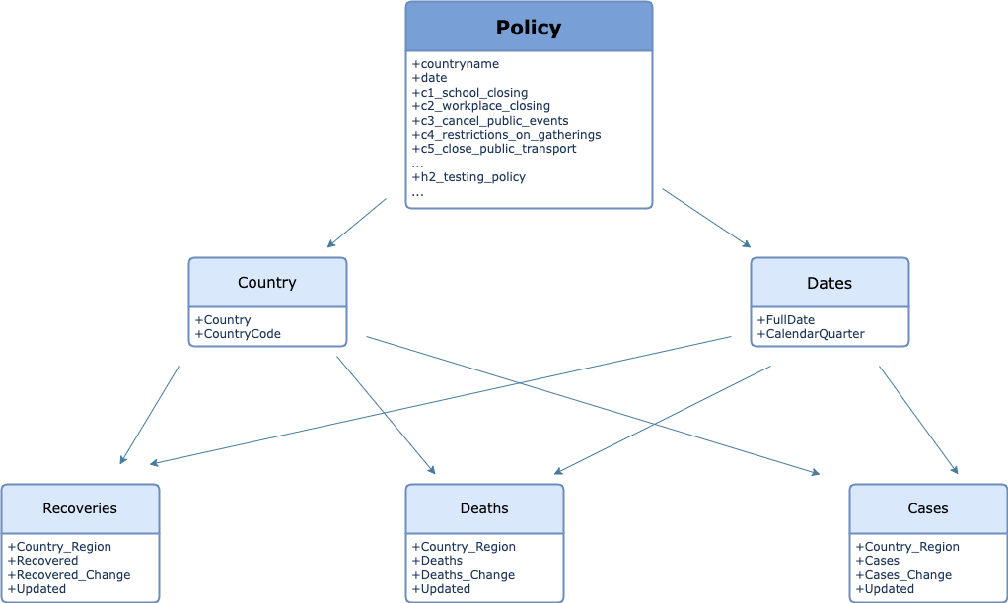
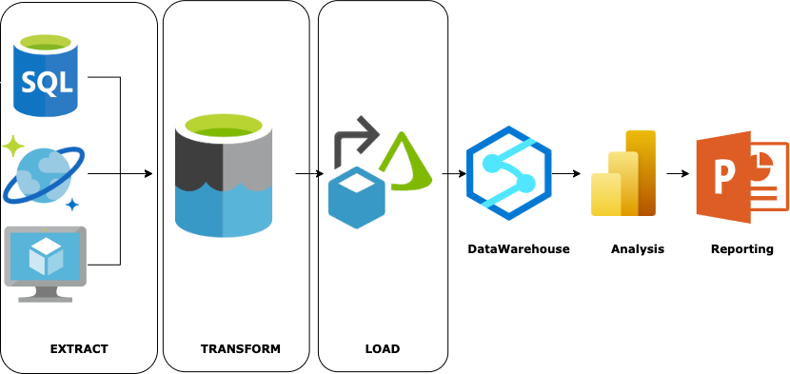
Architectural and Schema Overview
Architecture
Snowflake Schema
Architecture
Snowflake Schema

Slide 4
Policy Introduction
Policy 1 (​c5_2): Public Transportation - Require Closing
Require closing - all must be closed/passengers are prohibited (NIH)
Policy 2 (h3_2): Testing Policy - Open Public Testing
Open public testing - “drive through” testing available to both symptomatic and asymptomatic people (NIH)

Slide 5
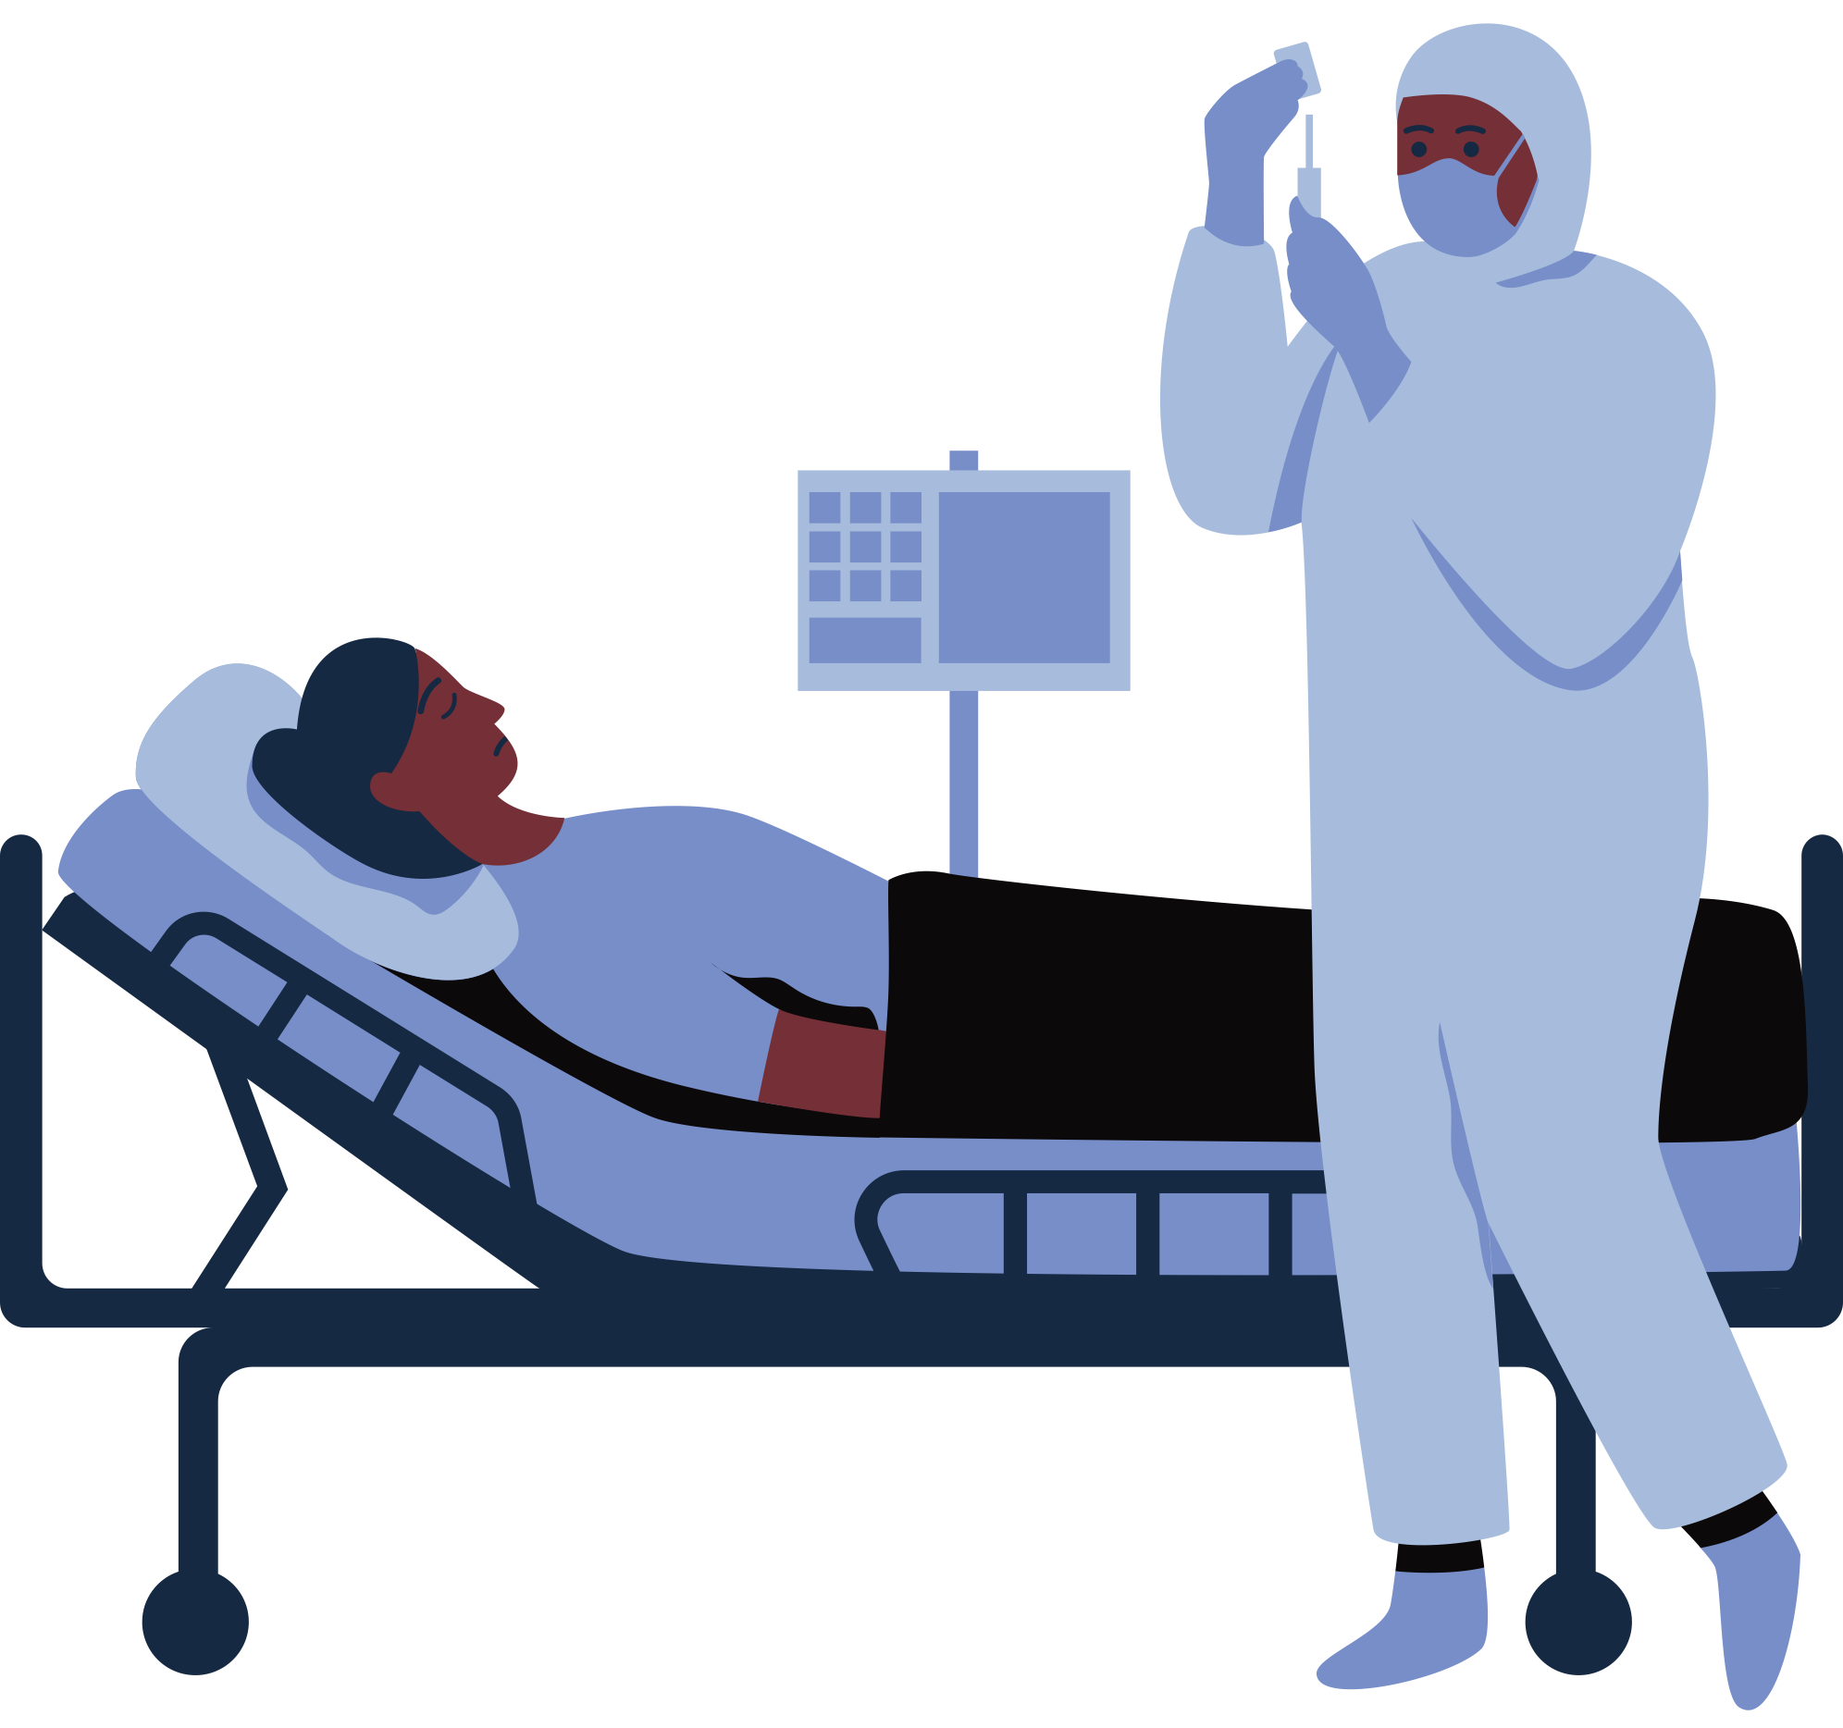
Now Our PowerBI Demonstration!

Slide 6
Thank you
Any Questions?

